Slide 1
Spark ML
Week-2
This module demystifies the concepts and practices related to machine learning using SparkML and the Spark Machine learning library. Explore both supervised and unsupervised machine learning. Explore classification and regression tasks and learn how SparkML supports these machine learning tasks. Gain insights into unsupervised learning, with a focus on clustering, and discover how to apply the k-means clustering algorithm using the Spark MLlib. Complete this learning with the lab that solidifies your learning and gain real-world experience with Spark ML.
Learning Objectives
Define machine learning​, summarize Spark MLlib capabilities​, and describe Spark MLlib pipeline capabilities and benefits.
Describe supervised learning and its relationship to regression, describe classification and regression and explain how SparkML supports machine learning tasks.
Describe unsupervised learning, define clustering, and discover how to apply the k-means clustering algorithm using the Spark MLlib.
Create a Jupyter Notebook on Watson Studio that has a Python kernel with Apache Spark ML installed.

Slide 2
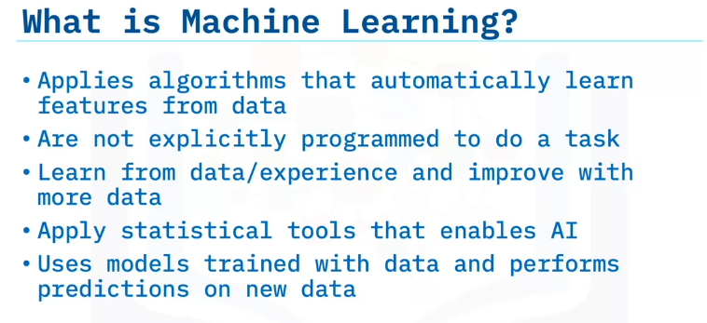
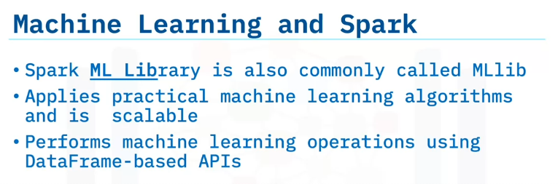
SparkML Fundamentals
Define machine learning.
Summarize Spark ML lib capabilities.
Describe Spark ML lib pipeline capabilities and benefits
Machine learning is a branch of computer science and statistics that deals with algorithms that automatically learn from data.
These algorithms are not explicitly programmed to do a task.
Instead, these algorithms learn from data and experience.
Machine learning systems generally tend to improve in performance with more data provided to them.
Machine learning applies statistical tools that are the backbone of artificial intelligence.
A machine learning system applies a specific machine learning mode to train data models.
After training the model, the system infers or “predicts” results on previously unseen data.
The Spark ML library is commonly referred to as ML lib, ML-lib stands for machine learning library and is Spark’s machine learning API.
ML lib applies practical machine learning algorithms and is scalable.
ML lib performs machine learning operations, including training models, using DataFrame-based APIs.

Slide 3
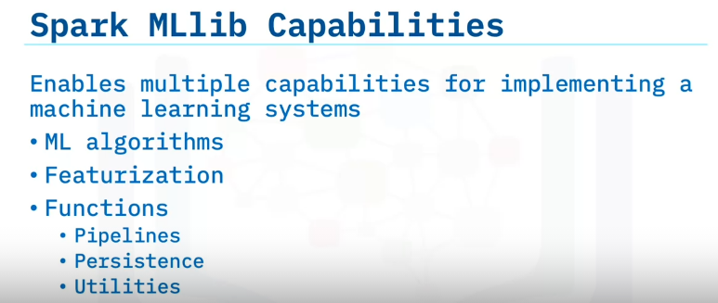
ML lib provides many tools to implement a Machine Learning system, such as machine learning algorithms:
Spark ML lib comes prepackaged with standard machine learning algorithms for clustering, classification, regression, and other tasks.
In addition, ML lib offers featurization with functions that easily extract features of interest from raw data, including functions for feature extraction, dimensionality reduction, and string tokenization, and others.
Let’s check out three Spark functions:
Pipelines: Spark ML lib exposes a pipeline API that makes the machine learning end-to-end system easier to develop, train and deploy.
Persistence: You can save and load models and pipelines easily using Spark ML lib. Persistence is beneficial for models trained on large datasets that require multiple training checkpoints.
Utilities: Spark ML lib eases day-to-day machine learning tasks with handy functions from statistics, linear algebra, image processing, and others.

Slide 4
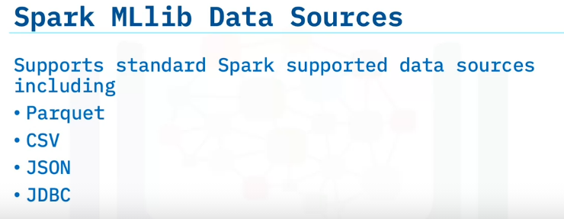
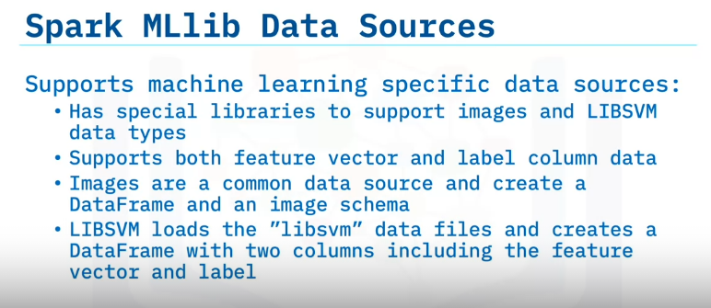
ML lib supports standard Spark-supported data sources, including Parquet, CSV, JSON, and
JDBC.
ML lib also has special libraries to support images and LIBSVM data types and supports both a feature vector and a label column data.
Images are a common and frequently used data source for machine learning models, especially for Computer Vision applications
LIB SVM is a type of DataFrame that has a feature vector and a label column.

Slide 5
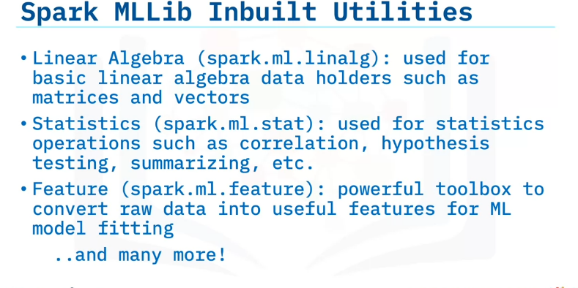
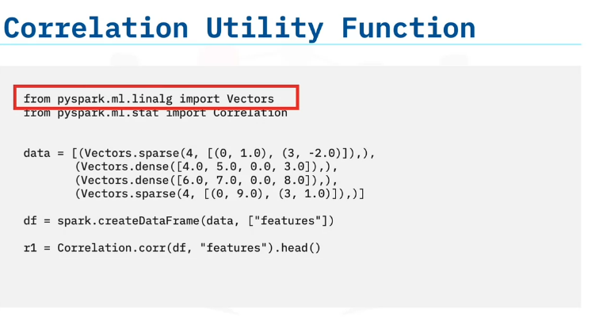
ML lib includes many inbuilt utility functions, which help during the intermediate steps of data processing, cleaning, and model building.
Here are several commonly used utilities.
The linear algebra package implements basic linear algebra data types such as vectors and matrices.
The statistics package contains functions to calculate correlation and perform hypothesis testing.
The “feature” module converts raw data into useful features that train the machine learning models.
Let’s check out this example that shows the use of the correlation utility functions This example uses the linear algebra library to create vectors.
Then, the statistics library determines the correlation between these vectors

Slide 6
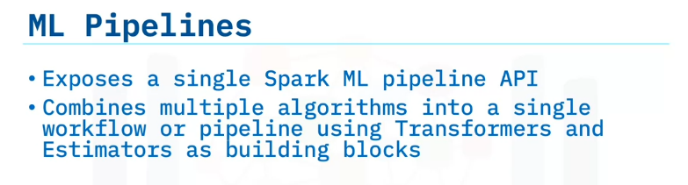
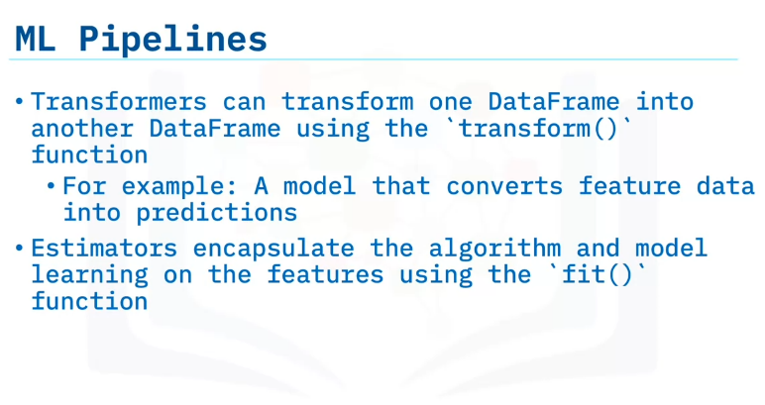
Another essential member of the Spark machine learning ecosystem is machine learning pipelines.
Spark exposes a pipeline API to build machine learning pipelines.
Machine learning pipelines combine multiple algorithms and pieces of a machine learning system into a single workflow or pipeline.
Transformers, as the name suggests, convert the data in one DataFrame into a different DataFrame.
For example, a machine learning model is a transformer object that converts feature data into predictive data.
Estimators encapsulate the algorithm and the learning process that the models undergo on training data.
You can use Transformers, Estimators, and the Pipeline API to build machine pipelines on Spark.

Slide 7
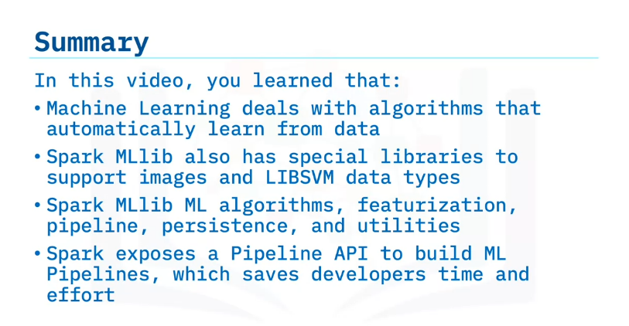

Slide 8
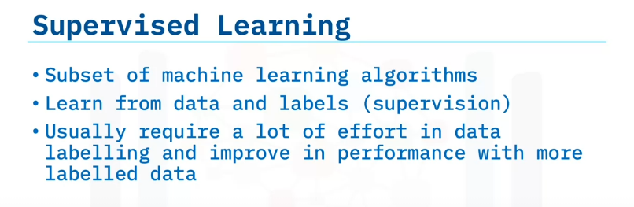
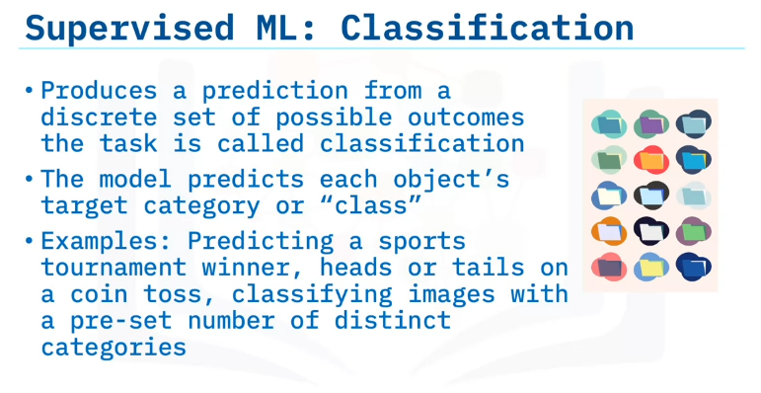
Classification and Regression using Apache Spark
Describe supervised learning and its relationship to regression.
Explain the differences between classification and regression.
Describe how SparkML supports machine learning tasks.
Supervised learning is a subset of machine learning algorithms.
In supervised learning, the machine learning model learns from data and corresponding labels.
The explicit labeling of data imparts the “supervision” aspect to supervised learning.
In most cases, a supervised learning model improves with more high-quality labeled data.
However, labeling data is often time-consuming and expensive.
Classification is a supervised machine learning task that produces a prediction or output from a discrete set of possible outcomes.
The model, in this case, tries to predict the class each object belongs to.
For example: predicting the winner in a sports tournament, predicting heads or tails on a coin toss, classifying images, and others.
In each of these examples, the model determines each outcome by assigning a class to the input object.

Slide 9
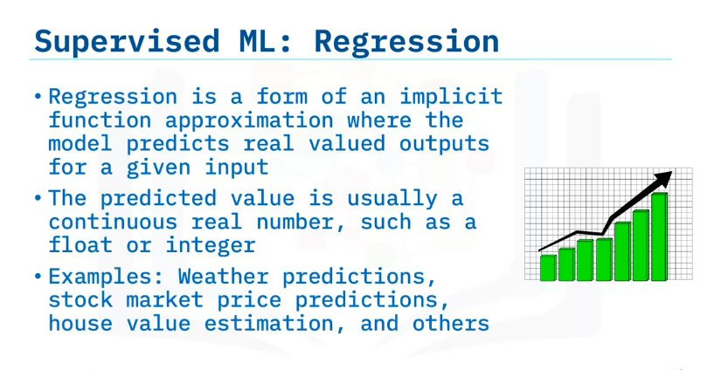
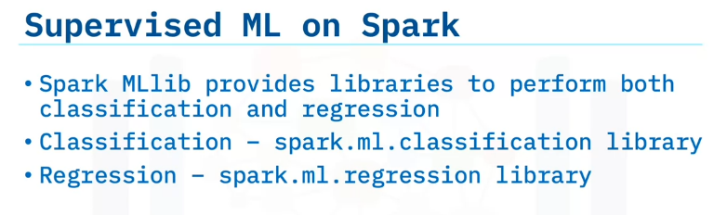
On the other hand, when a model approximates an implicit function and predicts values for an input variable, we call this task regression.
The predicted value is usually a continuous real number, such as a float or an integer.
Weather predictions, stock market price prediction, house value estimation, and others make use of regression. Note how the model estimates f of x where x is a variable in each example.
With weather prediction, we can think of weather as f of t, a function of time, and the regression task is to estimate what that function looks like or what value f of t has for all possible
How do you perform supervised machine learning on Apache Spark?
Spark ML Lib provides libraries for both classification and regression.
Use the spark dot m l dot classification library for classifications.
And use the spark dot m l dot regression library for regressions.

Slide 10
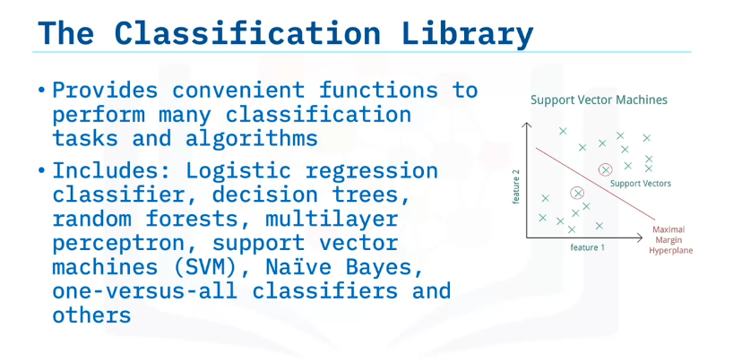
The Spark ML Classification Library comes with inbuilt implementations of standard classification algorithms such as Logistic regression classifier, decision trees, random forests, support vector machines, Naïve Bayes, one-versus-all classifiers, and others.

Slide 11
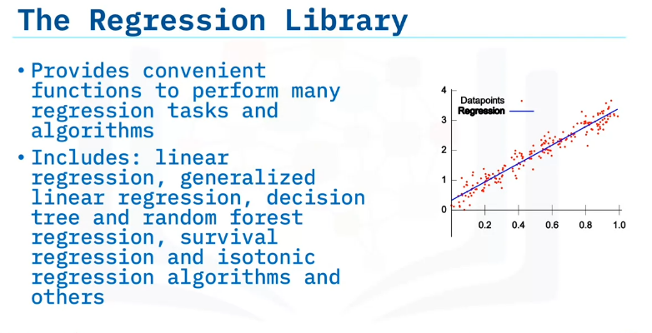
Similarly, the Spark Regression Library provides inbuilt implementations of standard regression algorithms such as linear regression, generalized linear models, decision tree regression, survival regression, isotonic regression algorithms, and others.

Slide 12
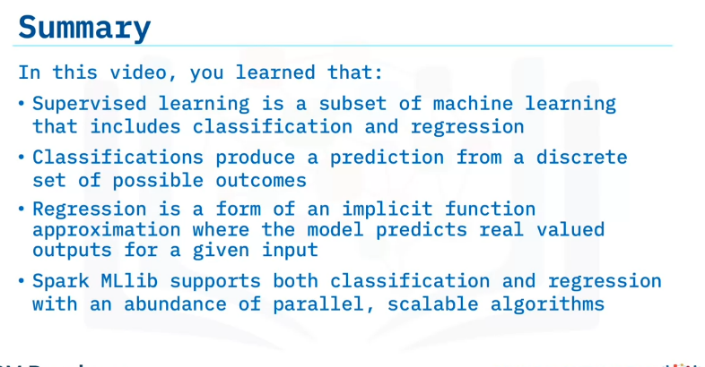

Slide 13
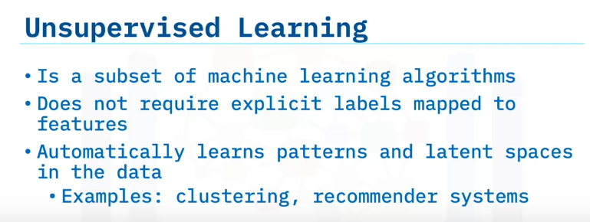
SparkML Clustering
Compare supervised and unsupervised learning.
Define clustering, one type of unsupervised learning.
Apply the k-means clustering algorithm with Spark MLlib.
One popular subset of machine learning is unsupervised learning.
As the name suggests, unsupervised learning does not involve any supervision.
In contrast to supervised learning, unsupervised learning does not use explicitly labeled datasets comprised of features mapped to labels to train the model.
Instead, the model automatically learns patterns and groups, also known as latent spaces, within the data.
Unsupervised learning is generally more advanced and more complex to perform than supervised learning.
Examples of unsupervised learning include clustering algorithms and recommender systems.

Slide 14
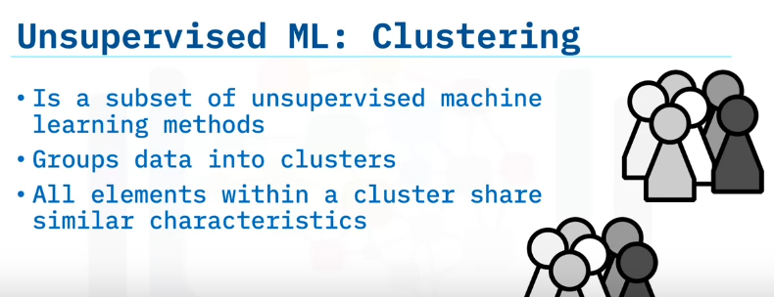
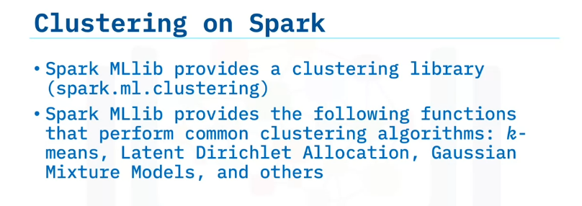
Clustering is an unsupervised machine learning technique used to predict clusters in a dataset.
In clustering, a machine learning model tries to divide the dataset into clusters or groups.
All elements within a cluster share similar characteristics.
How does Spark enable clustering?
Spark MLlib provides a clustering library that includes commonly used clustering algorithms such as k-means, Latent Dirichlet Allocation, Gaussian Mixture Models, and others.

Slide 15
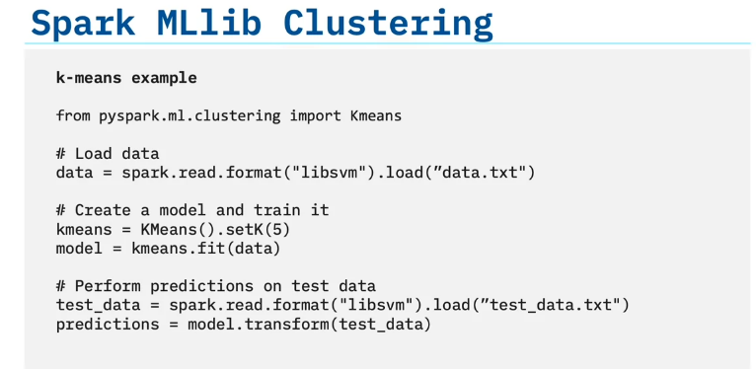
Let’s view an example of how to perform clustering on Spark.
Clustering is useful for market segmentation; image segmentation, image compression, document clustering based on topics, and other segmentation tasks.
The first line displays the import of the clustering library, where you can see the k-means algorithm in use.
The line of code loads the data using the read function.
You’ll see how LIBSVM within ML lib enables the direct reading of that format.
The next step is to create a clustering model.
In this case, the clustering model uses k equals five.
Specifying that k equals five means that the model will split the dataset into five clusters.
You’ll use the fit function—with k-means is an estimator—to train the model.
Finally, you’ll perform inference or predictions on new unseen data.
The model assigns each element of the new dataset to one of the five existing clusters the model created during the training process.
You will then see the transform function, which converts test data into predictions, cluster assignments in this case.

Slide 16
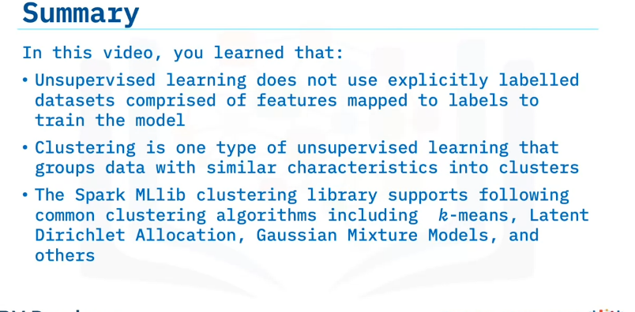

Slide 17
Summary & Highlights
In this module, you learned that:
Machine learning is a branch of computer science and statistics in which algorithms are not explicitly programmed to do a task but learn from data and experience. Spark MLlib is prepackaged with standard machine learning algorithms for clustering, classification, regression, and other tasks.
Spark MLlib offers featurization with functions that easily extract features of interest from raw data, including functions for feature extraction, dimensionality reduction, and string tokenization, and others.
Spark MLlib offers functions for pipelines and persistence and utilities for day-to-day machine learning tasks with handy functions for statistics, linear algebra, image processing, and others.
Supervised learning, a subset of machine learning, includes classification and regression. Classification produces a prediction from a discrete set of possible outcomes. Regression is an implicit function approximation where the model predicts real-valued outputs for a given input. Spark MLlib supports both classification and regression with an abundance of parallel, scalable algorithms
A popular subset of Machine Learning is unsupervised learning. The models automatically learn patterns and groups during unsupervised learning, also known as latent spaces, within the data. Unsupervised learning is generally more advanced and more complex to perform than supervised learning. Examples of unsupervised learning include clustering algorithms and recommender systems.
In clustering, a machine learning model tries to divide the dataset into clusters or groups. All elements within a cluster share similar characteristics. The k-means algorithm helps you train the data model by splitting the dataset into a specified number of clusters. You can then use the fit function—with k-means as an estimator—to train the model.

Slide 18
https://cf-courses-data.s3.us.cloud-object-storage.appdomain.cloud/IBM-BD0231EN-SkillsNetwork/labs/SparkML.ipynb
https://cf-courses-data.s3.us.cloud-object-storage.appdomain.cloud/IBM-BD0225EN-SkillsNetwork/labs/SparkIntro.ipynb
smitshah1920/component-library: The goal of CLAIMED is to enable low-code/no-code rapid prototyping style programming to seamlessly CI/CD into production. (github.com)
deployment
SPACE GUID : 31883e79-cba9-4fa3-8629-e08a3345a158
API Key : 1W04IfgheNcmj5AK99xhwV3Sv-osqaI8RMjmlztHZxYh

